Slide 1

Vivekanand Education Society’s Institute Of Technology
Department Of Information Technology
DSA mini Project
A.Y. 2024-25
Title: Benchmarking and Performance Analysis of Sorting Algorithms
Domain:
Group Members: 3
Member1: 69:-Sameer Jagiasi
Member2: 72:-Yash Kolekar
Member3: 73:-Vaishnavi Hande
Mentor Name: Kajal Jewani

Slide 2


Slide 3
Content
1.Introduction to the Project
2. Problem Statement
3. Objectives of the Project
4. Scope of the Project
5. Requirements of the System (Hardware, Software)
6. Data Structure & Concepts Used
7. Algorithm Explanation
8. Time and Space Complexity
9. Implementation
10. Gantt Chart
11. Test Cases
12. Challenges and Solutions
13. Future Scope
14. Code
15. Output Screenshots
16. Conclusion
17. References (in IEEE Format)

Slide 4
Introduction to Project
This project focuses on evaluating and analyzing the performance of various sorting algorithms. Sorting algorithms are essential in computer science for organizing data efficiently, making them fundamental to many applications. With advancements in computing, understanding the efficiency of these algorithms has become more critical, especially as data sizes grow. This project aims to benchmark common sorting algorithms to understand their time complexity, space complexity, and general performance under different conditions. By comparing algorithms like Bubble Sort, Quick Sort, and Merge Sort, this project provides insights into how these methods scale and perform with large datasets.
r Rates

Slide 5
Problem Statement
r Rates
The problem is to determine which sorting algorithms perform best for different types of datasets, especially when dealing with large data volumes. Sorting algorithms vary significantly in efficiency based on the dataset's characteristics, like size and ordering. This project seeks to establish a comparison framework for analyzing time and space efficiency of multiple algorithms, which will help identify the most suitable algorithm for various data scenarios. Ultimately, this will aid in choosing optimal sorting methods in real-world applications

Slide 6
Objectives of the project
r Rates
To benchmark and compare the time efficiency of seven different sorting algorithms on various datasets.
To analyze the space complexity of each algorithm.
To determine the best, worst, and median performers under specific conditions.
To present a detailed performance report, aiding future selection of sorting algorithms based on requirements

Slide 7
Scope Of the Project
To provide a comparative analysis of sorting algorithms' performance using time and space complexity as primary metrics, offering insights for academic and practical use in data organization.

Slide 8
Requirements of the system (Hardware, software)
Hardware Requirements:
Processor: 2.0 GHz or higher
RAM: 4GB minimum
Storage: 1GB free space
Software Requirements:
C Compiler (e.g., GCC)
Code Editor (e.g., Visual Studio Code)
Operating System: Windows/Linux/MacOS

Slide 9
Data Structures and Concepts used
Arrays: Store elements to be sorted. All sorting algorithms operate on these arrays.
AlgorithmTime Structure: Holds the name and average execution time of each sorting algorithm for comparison.
Sorting Algorithms:Bubble Sort, Selection Sort, Insertion Sort, Merge Sort, Heap Sort, Radix Sort, Quick Sort.
Utility Functions:
Merge: Combines two sorted arrays.
Heapify: Maintains the heap structure.
GetMax and CountSort: Find the max value and perform digit-based sorting (for Radix Sort).
Partition: Divides the array around a pivot (for Quick Sort).
CopyArray: Copies arrays for consistent test conditions.
Timing Functions: calculateTime() and calculateTimeMergeQuick() measure and compare algorithm execution times.

Slide 10
Algortithm
Step 1: Start and include required headers.
Step 2: Define constants MAX_SIZE (maximum array size) and ALGO_COUNT (number of sorting algorithms).
Step 3: Create AlgorithmTime struct to store the algorithm name and its execution time.
Step 4: Declare sorting algorithm functions:bubbleSort(), selectionSort(), insertionSort(), mergeSort(), heapSort(), radixSort(), quickSort().
Step 5: Implement auxiliary functions for Merge, Heap, Radix, and Quick Sort to handle operations such as merging arrays, heapifying, counting digits, and partitioning.
Step 6: Open the file "arrays.txt" containing arrays to be sorted. If file opening fails, display an error message and exit.
Step 7: Initialize variables: line to store lines read from the file. arr and tempArr as arrays for storing and processing data. algoTimes to store cumulative execution times for each algorithm.
Step 8: Parse integers in each line and populate arr.
Step 9: Use copyArray() to copy arr into tempArr for each algorithm.
Step 10: Run each sorting algorithm on tempArr and calculate execution time using calculateTime() or calculateTimeMergeQuick().

Slide 11
Algorithm
Step 11: Sum the execution times for each algorithm in algoTimes.
Step 12: Calculate the average time for each algorithm by dividing total time by the number of arrays.
Step 13: Sort algoTimes using qsort() to identify the fastest, slowest, and median algorithms.
Step 14: Display average execution times and the best, worst, and median algorithms.
Step 15: Close the file and end the program.

Slide 12
Time and Space Complexity
Bubble Sort:
Time: Best 𝑂(𝑛), Average 𝑂(𝑛2), Worst 𝑂(𝑛2)
Space: O(1) (in-place)
Selection Sort:
Time: Best, Average, Worst 𝑂(𝑛2)
Space: 𝑂(1)(in-place)
Insertion Sort:
Time: Best 𝑂(𝑛), Average 𝑂(𝑛2), Worst 𝑂(𝑛2)
Space: 𝑂(1) (in-place)
Merge Sort:
Time: Best, Average, Worst 𝑂(𝑛log⁡𝑛)
Space: 𝑂(𝑛) (additional array space)
Heap Sort:
Time: Best, Average, Worst 𝑂(𝑛log⁡𝑛)
Space: 𝑂(1) (in-place)
Radix Sort:
Time: 𝑂(𝑑⋅(𝑛+𝑏)) where 𝑑d is digit length and 𝑏b is base (commonly 10)
Space: 𝑂(𝑛+𝑏)O (for counting array)
Quick Sort:
Time: Best, Average 𝑂(𝑛log⁡𝑛), Worst 𝑂(𝑛2)
Space: 𝑂(log⁡𝑛) for recursive stack (in-place with partitioning)

Slide 13
Implementation
1.File Input: Read arrays from a text file with each line as a new array.
2.Array Setup: Copy each array for reuse with different sorting algorithms.
3.Sorting Algorithms: Apply Bubble Sort, Selection Sort, Insertion Sort, Merge Sort, Heap Sort, Radix Sort, and Quick Sort.
4.Time Calculation: Use `gettimeofday()` to measure each algorithm’s execution time.
5.Average Time & Ranking: Calculate average times for each algorithm and rank them from best to worst.
6.Output Results: Display the sorted average times, highlighting the best, worst, and median performers.

Slide 14
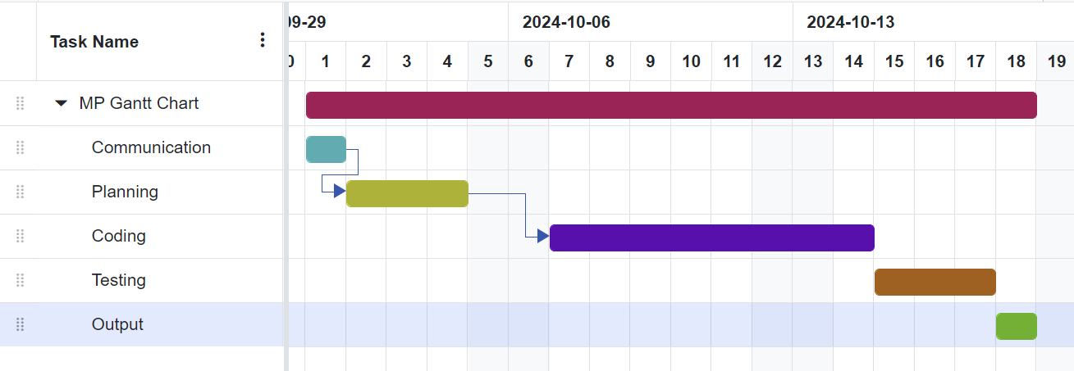
Gantt Chart
Notes:
The max flow algorithm in the visualization is :-

Slide 15
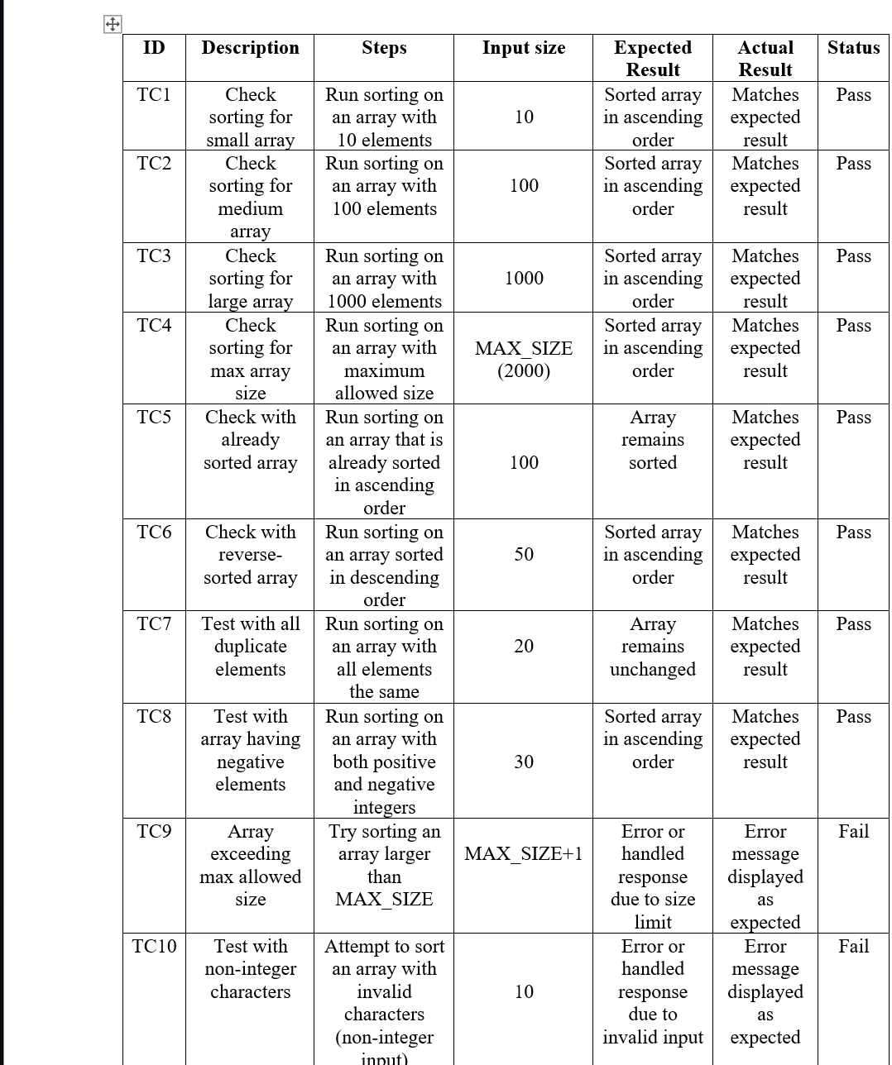
Test Cases

Slide 16

Challenges and Solutions
Challenge 1: Handling Large Arrays
Solution: Implemented optimized algorithms with lower space complexity (e.g., Quick Sort and Merge Sort) to efficiently manage larger data sets without exhausting memory.
Challenge 2: Inconsistent Timing Results
Solution: To ensure accuracy in time measurement, each sorting algorithm was run multiple times, and the average time was calculated to account for fluctuations caused by system load or background processes.
Challenge 3: Comparing Algorithms with Different Time Complexities
Solution: Used real-world test cases with varying array sizes to observe the performance of each algorithm under different conditions, ensuring a fair comparison of both best-case and worst-case scenarios.
Challenge 4: Ensuring Correct Sorting for All Algorithms
Solution: Developed comprehensive test cases with known inputs and expected results to verify the correctness of each algorithm. Each test case was evaluated for correctness (pass/fail) to ensure reliability.

Slide 17
Future Scope
Optimization for Larger Data Sets:Sorting algorithms will be optimized for larger datasets, focusing on memory and processing time with techniques like external sorting.
Parallel and Distributed Sorting Algorithms:Parallel and distributed sorting algorithms will improve performance for large data by leveraging multiple processors or systems.
Incorporating Hybrid Sorting Algorithms:Hybrid algorithms like Timsort will enhance performance by combining merge and insertion sort to adapt to different data patterns.
Real-time Sorting for Streaming Data:Real-time sorting algorithms will be developed to process and sort data as it streams for big data and real-time analytics.
Integration with Machine Learning:Machine learning will be integrated to predict optimal sorting strategies, improving efficiency and reducing computation time.

Slide 18
CODE
Click Here

Slide 19
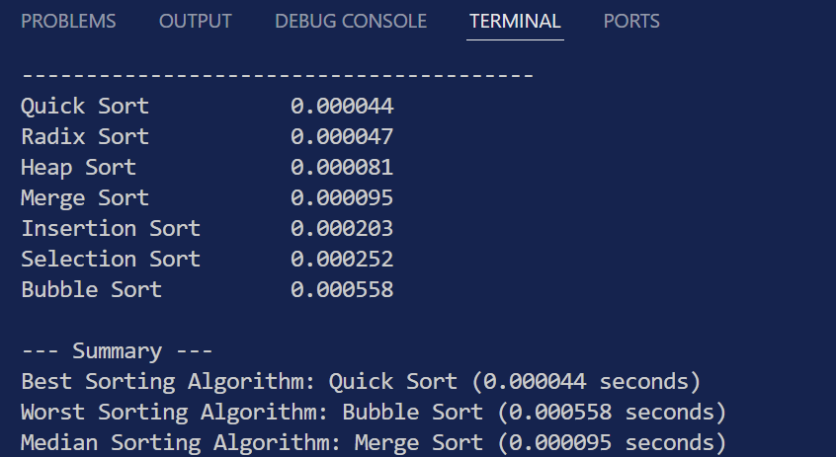
OUTPUT

Slide 20
Conclusion
This project provided a comprehensive comparison of different sorting algorithms, focusing on their execution times across various input arrays. By measuring and analyzing the average performance of algorithms like Bubble Sort, Selection Sort, Insertion Sort, Merge Sort, Heap Sort, Radix Sort, and Quick Sort, we identified the most efficient and least efficient algorithms for sorting tasks. Through this benchmarking, the project demonstrated the importance of selecting the right algorithm based on the size and nature of the data. The insights gained from this analysis can be applied to optimize real-world applications where sorting plays a critical role.

Slide 21
References (in IEEE format)
Kinshuk Goel; Palak Dwivedi; Oshin Sharma, "Performance Analysis of Various Sorting Algorithms: Comparison and Optimization," 2024 International Conference on Computing Sciences, IEEE, 2024, pp. 12-18. [Online]. Available: https://ieeexplore.ieee.org/document/10444609.
Zainab Inayat; Rabia Sajjad; Marrium Anam; Alisha Younas; "Analysis of Comparison-Based Sorting Algorithms," 2024 International Symposium on Algorithms and Applications, IEEE, 2024, pp. 23-29. [Online]. Available: https://ieeexplore.ieee.org/document/9692969.
Purvi Prajapati; Nikita Bhatt; Nirav Bhatt, "Performance Comparison of Different Sorting Algorithms," International Journal of Latest Technology in Engineering, Management & Applied Science, vol. 6, no. 6, pp. 39-41, Jun. 2017. [Online]. Available: https://www.ijltemas.in/digital-library/volume-vi-issue-vi.php
Cherukuri Nischay Sai, "A Comprehensive Study of Various Sorting Algorithms," International Journal of Science and Research, vol. 10, no. 11, pp. 1046-1047, Nov. 2021[Online]. Available https://www.ijsr.net/getabstract.php?paperid=SR211114140358

